Slide 1


Development of a Network Time Protocol Amplification and DDoS Simulation Testing Framework
Presented By:
G.Raju (192411065)
M.Chaitanya(192472047)
)
Guided BY:
Dr. Ramesh kumar K

Slide 2
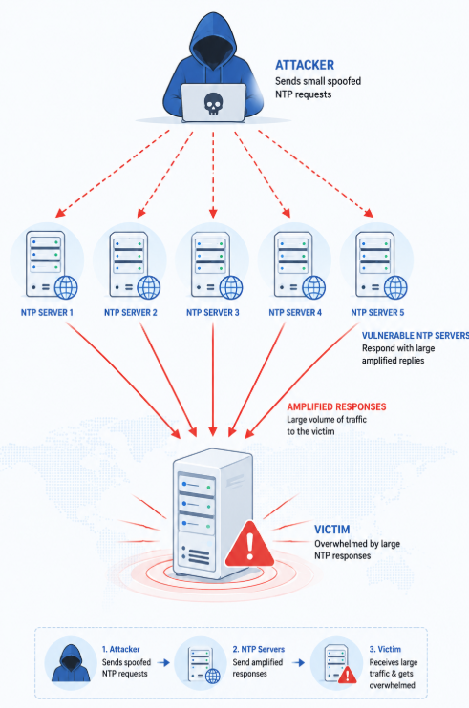
Introduction
Overview of the Project
Develop a framework to identify vulnerable NTP servers.
Simulate NTP amplification attacks in a controlled environment.
Analyze attack impact and evaluate mitigation techniques.
Generate detailed reports to help improve network security and resilience.
Problem Statement
Vulnerable NTP servers with monlist enabled can be exploited for DDoS attacks.
No single framework exists to detect vulnerabilities, simulate attacks, and evaluate defenses.
Organizations need a safe testing environment to evaluate network security without affecting live systems.

Slide 3
Objectives
Identify NTP servers that are vulnerable to amplification attacks.
Detect servers with the monlist feature enabled.
Simulate NTP amplification-based DDoS attacks in a controlled environment.
Measure the amplification factor, traffic volume, and network performance during attacks.
Evaluate the effectiveness of rate limiting and upstream traffic filtering as mitigation techniques.
Generate detailed reports and security recommendations to improve network resilience against NTP-based DDoS attacks.

Slide 4
Literature Review
Author / Year | Research Focus | Key Contribution | Limitation
Rossow (2025) | Studied amplification attacks using vulnerable UDP services, including NTP. | Identified amplification factors and vulnerable services. | Focused on attack analysis; limited mitigation evaluation
US-CERT (2023) | Published security guidelines to prevent NTP amplification attacks by disabling the monlist feature. | Recommended disabling the monlist feature. | Provided recommendations but no testing framework
Mirkovic & Reiher (2022) | Proposed DDoS defense mechanisms and attack classification techniques | Proposed DDoS defense and classification techniques. | Did not specifically address NTP amplification attacks.
Cloudflare Research | Implemented rate limiting and traffic filtering to mitigate large-scale DDoS attacks | Demonstrated practical DDoS mitigation approaches. | Primarily focused on production environments rather than simulation

Slide 5
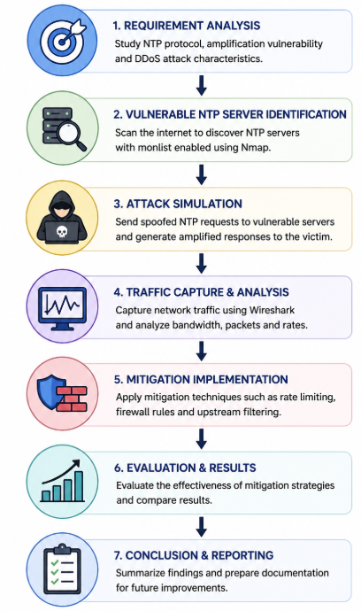
Methodology
Enumerated NTP servers to identify systems vulnerable to amplification attacks and detect the monlist feature.
Developed the testing framework using Python, Scapy, Nmap, and Wireshark for packet analysis and simulation.
Simulated NTP amplification attacks in a controlled environment to analyze traffic behavior and attack impact.
Collected and analyzed network data, including amplification factor, response size, bandwidth utilization, and packet statistics.
Implemented and evaluated mitigation techniques, such as rate limiting and upstream traffic filtering, to measure their effectiveness in reducing DDoS attacks.

Slide 6
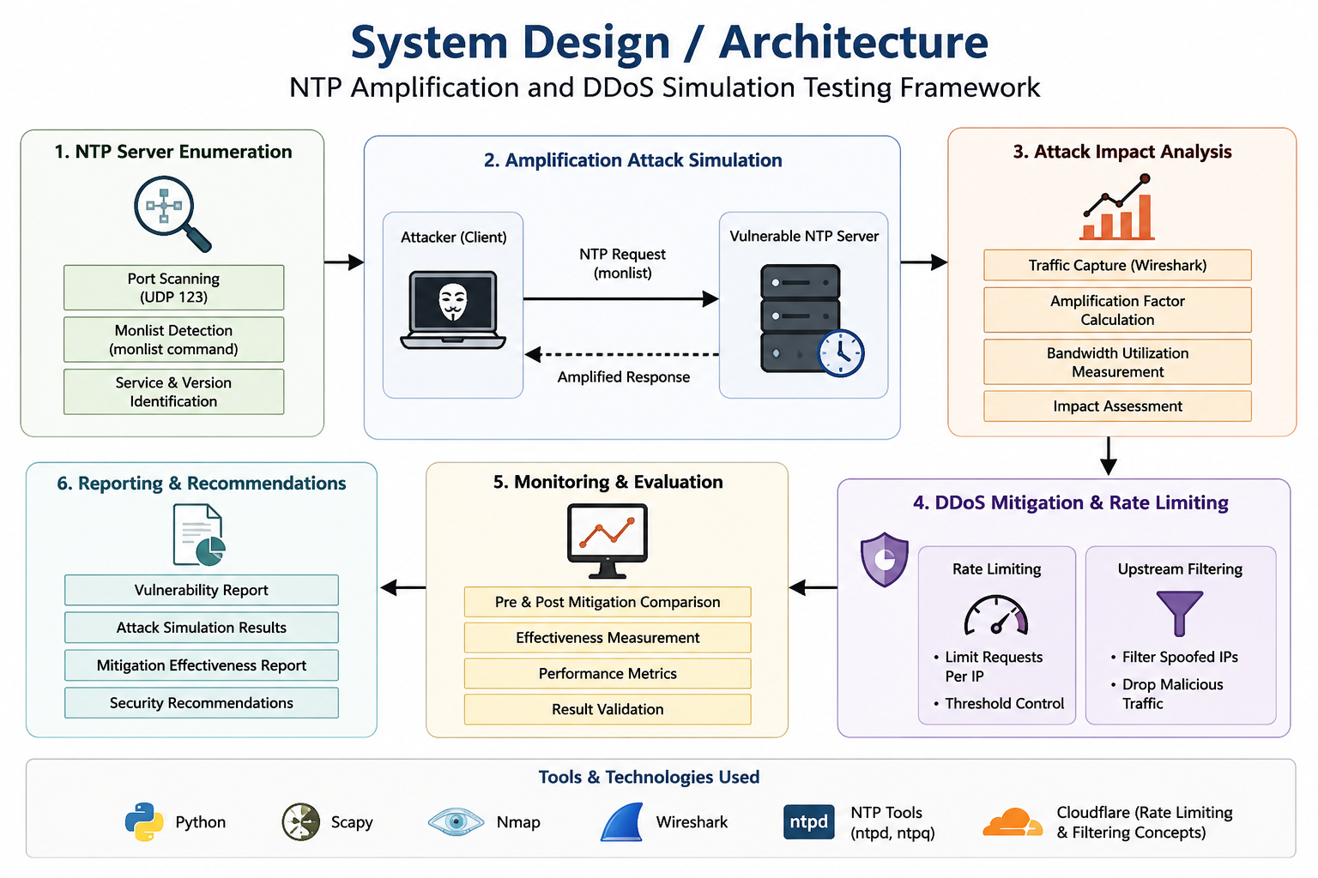

Slide 7
Module 1: NTP Server Enumeration & Monlist Detection Module
Finding NTP Servers: We searched the network for computers running NTP service by scanning UDP port 123 using Nmap tools and NTP queries.
Checking for the Monlist Flaw: We sent a special "monlist" request to each server. If a server sent back a big list of connected devices, we marked it as vulnerable and dangerous.
Calculating the Amplification Power: We compared the size of our small request to the giant response we got back. This gave us the amplification factor (for example, 1 small packet triggers 500x bigger traffic).
What We Delivered: A report listing all the risky servers, their addresses, response sizes, and how powerful each one could be in an attack.

Slide 8
Module 2: Amplification Attack Simulation Module
Creating Fake Attack Traffic: Using tools like hping3 and Python scripts, we built fake NTP request packets in a closed lab — completely isolated so no real network was harmed.
Watching the Network Flood: We used iperf3 and Wireshark to measure how much fake traffic hit the target, and whether the network link became overloaded.
Recording the Damage: We tracked peak traffic volume, how much the target bandwidth filled up, and how much slower the network became compared to normal.
What We Delivered: Simulation results with graphs and numbers showing exactly how badly the attack could crush network performance.

Slide 9
Results & Discussion
Outcomes of the Project
Successfully identified NTP servers vulnerable to amplification attacks.
Simulated NTP amplification attacks and measured their impact on network traffic.
Evaluated mitigation techniques to reduce attack intensity and bandwidth consumption.
Comparison with Existing Solutions
Integrates vulnerability detection, attack simulation, and mitigation testing into a single framework.
Provides real-time traffic analysis and performance evaluation compared to conventional standalone tools.

Slide 10
Challenges & Limitations
Controlled Environment: The framework is tested in a controlled laboratory setup, so results may differ from real-world network environments.
Limited Vulnerable Servers: Most modern NTP servers have the monlist feature disabled, making vulnerable servers difficult to identify.
Resource Constraints: Simulating large-scale NTP amplification attacks requires significant computing power, bandwidth, and network resources.
Mitigation Effectiveness: Rate limiting and upstream filtering reduce attack impact but cannot completely eliminate all DDoS threats.
Limited Scope: The framework focuses only on NTP amplification attacks and does not cover other DDoS amplification protocols or attack methods.

Slide 11
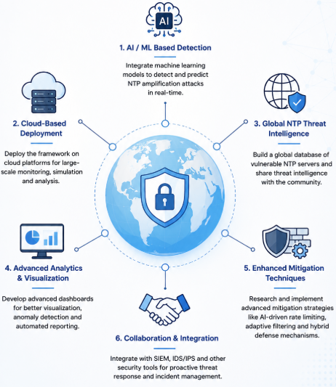
Future Scope
AI-Based Threat Detection
Integrate Machine Learning (ML) models to detect and predict NTP amplification attacks in real time.
Cloud-Based Deployment
Deploy the framework on cloud platforms for scalable testing, monitoring, and remote access.
Multi-Protocol Support
Extend the framework to analyze other amplification attacks such as DNS, SSDP, Memcached, and CLDAP.
Advanced Monitoring Dashboard
Develop a real-time dashboard to visualize attack traffic, performance metrics, and mitigation status.

Slide 12
Conclusion
Successfully developed a framework to identify vulnerable NTP servers and simulate NTP amplification attacks.
Analyzed the impact of amplification attacks using traffic, bandwidth, and network performance metrics.
Evaluated mitigation techniques including rate limiting and upstream traffic filtering.
Demonstrated a secure and controlled environment for cybersecurity testing and research.
Concluded that the proposed framework helps improve network security and strengthens defenses against NTP-based DDoS attacks.

Slide 13
References
[1] C. Rossow, “Amplification Hell: Revisiting Network Protocols for DDoS Abuse,” in Proc. Network and Distributed System Security Symposium (NDSS), San Diego, CA, USA, Feb. 2025.
[2] US-CERT, “NTP Amplification Attacks Using the Monlist Command,” Alert TA14-013A, Jan. 2024.
[3] P. Ferguson and D. Senie, “Network Ingress Filtering: Defeating Denial of Service Attacks Which Employ IP Source Address Spoofing,” RFC 2827, Internet Engineering Task Force (IETF), May 2022.
[4] A. Mirkovic and P. Reiher, “A Taxonomy of DDoS Attack and DDoS Defense Mechanisms,” ACM SIGCOMM Computer Communication Review, vol. 34, no. 2, pp. 39–53, Apr. 2022.
[5] D. Mills, J. Martin, J. Burbank, and W. Kasch, “Network Time Protocol Version 4: Protocol and Algorithms Specification,” RFC 5905, Internet Engineering Task Force (IETF), Jun. 2021.

Slide 14


